Slide 1
The PIC microcontroller
PIC18F4520: Interrupts

Slide 2
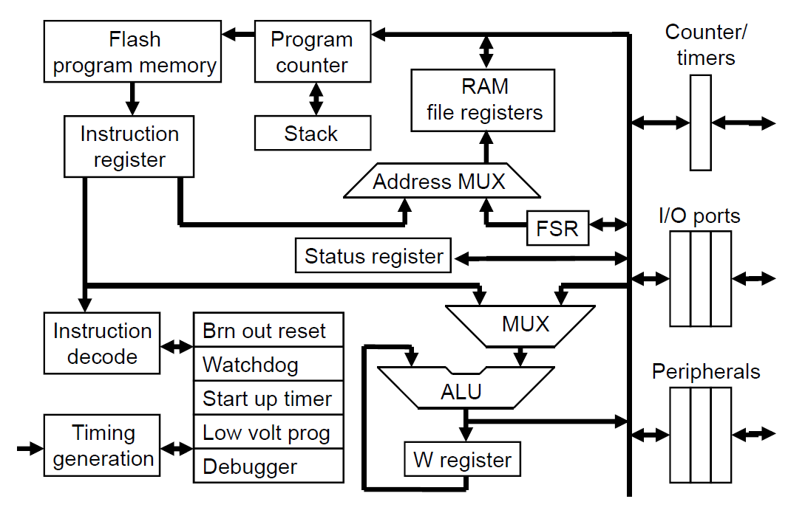
PIC18F: Controller Architecture

Slide 3
PIC18F: Notational convention
WREG
W Register
FREG
File Register (any register location from GPR Bank 0 / SFR)
[X]
Contents of register X
[WREG] = 0x02 ↔ WREG’s contents become 0x02
[0x20] = 0x34 ↔ RAM File Register 0x20 content becomes 0x34
[X] = [Y] ↔ Contents of Y are copied into X
Number systems
Decimal | d’10’
Hexadecimal | h’4A’ or 0x4A
Binary | b’1000 0010’

Slide 4
interrupts

Slide 5
Programming: Concept of ‘interrupt’
Controller interaction with devices
Internal devices
(Multiple) Timers, Counters, ADCs, CCP modules
External devices
Modes of interaction
Servicing
Keyboard, mouse, joystick
Controlling
LEDs, 7-segment LEDs, LCDs, Monitors, Displays, Motors
Collecting data
Sensors, Accelerometers, Gyroscopes, Cameras, USB devices
Monitoring
As device interaction increases
Polling through sequential code becomes onerous
Make the device that needs service ‘interrupt’ the CPU
Send a special signal to get CPU attention
CPU free to do ‘other’ work - freedom from continuous polling

Slide 6
PIC18F: Interrupts and types
PIC18F has many types of interrupts
Internal module originated
Timer interrupts
USART/UART interrupts
PORTB Change interrupts
ADC interrupts
CCP generated interrupts
SSP (synchronous serial port) interrupts
External (hardware triggered)
Pin based
General interrupt mechanism
IE (interrupt enable) bit in some register
If 1, interrupt is enabled
IF (interrupt flag) bit in some register
Goes from 0 to 1 when the ‘interrupt’ comes in

Slide 7
PIC18F: Interrupt – Controls
On boot, PIC18F has all interrupts disabled
2 levels of interrupt control
Global level
GIE bit of INTCON register (actually, GIEH bit)
If this bit is zero, all interrupts are disabled
Device/type level
IE flag controlled
Example: Timer0 interrupt is enabled if TMR0IE is 1
Illustration: Bit mapping for timer interrupts
.
.
Timer | Enable bit (Register) | Flag bit (Register)
TMR0 | TMR0IE (INTCON) | TMR0IF (INTCON)
TMR1 | TMR1IE (PIR1) | TMR1IF (PIE1)
TMR2 | TMR2IE (PIR1) | TMR2IF (PIE1)
TMR3 | TMR3IE (PIR3) | TMR3IF (PIE2)

Slide 8
PIC18F: Interrupt – Framework
Interrupt vectors - fixed
By default, all interrupts are ‘high priority’
Usually hold hard-jumps; actual handling code will lie elsewhere
ISR (Interrupt Service Routine)
Interrupt handler code
Function – automatically called, and returns differently
What happens on an interrupt?
If interrupt’s IE bit is 1, and if the interrupt occurs
GIE is disabled, CPU jumps to the interrupt vector location
Hard jump at this location will call the ISR
ISR returns with RETFIE ⇒ enables GIE, then RETURNS
Reset vector | 0x0000
High priority interrupt vector | 0x0008
Low priority interrupt vector | 0x0018

Slide 9
PIC18F: Interrupt – Code flow
Code memory
0x000
GOTO START
Reset
On power-up
Start from 0x0000
Hard-jump to START
Booting
Run START
On interrupt
GIE→0
Auto-jump to 0x0008
Hard-jump to ISR
Run ISR
RETFIE (GIE→1, RETURN)
Return to START
Resume running
0x002
0x004
0x006
0x008
GOTO ISR
Hi-prio
…
0x200
START …
0x202
--
…
--
…
--
…
--
ISR …
--
RETFIE

Slide 10
PIC18F: Interrupt – Simulation!
#include "P18F4520.inc"
CNT EQU d'10'
FREG EQU 0x10
ORG 0x0
GOTO START
ORG 0x08
ISR BCF INTCON, TMR0IF ; clear the IF flag!
RETFIE
ORG 0x200
START BSF INTCON, GIE ; enable global interrupts
BSF INTCON, TMR0IE ; enable TMR0 interrupts
MOVLW CNT
MOVWF FREG
L1 NOP
NOP
DECF FREG, F
BNZ L1
GOTO $
END
In INTCON: control TMR0IF, keep watch on GIE, TMR0IF!

Slide 11
PIC18F: Interrupt – Nesting
When an (enabled) interrupt occurs
It disables (other) interrupts globally [GIE→0]
And then jumps to its ISR to service/handle it
But what if another device interrupts the PIC now?!
Concept of ‘nested’ interrupts
Interrupts that interrupt an interrupt being serviced
By design, PIC can not handle nested interrupts

Slide 12
PIC18F: Nested Interrupts – Scenario
Assume a system using TMR0 and ADC
Instead of CPU polling, let them interrupt for service
Steps for handling the 2 devices:
Each interface needs its own ISR
TMR0_ISR, ADC_ISR
Interrupt flags need to be reset!
BCF INTCON, TMR0IF
BCF PIR1, ADIF
Interrupts need to be enabled
BSF INTCON, TMR0IE
BSF PIE1, ADIE
But we have only one vector location (0x0008)
So how do you place both ISRs?
Also, what if TMR0 interrupts…
When ADC_ISR is running?

Slide 13
PIC18F: Nested Interrupts – Template
Vector code
ORG 0x0008
GOTO ISR_MAPPER
ISR Mapper code
ORG 0x0040
ISR_MAPPER BTFSC INTCON, TMR0IF
GOTO TMR0_ISR
BTFSC PIR1, ADIF
GOTO ADC_ISR
RETFIE
ISR code
ORG 0x200 ORG 0x300
TMR0_ISR … ADC_ISR …
BCF INTCON, TMR0IF BCF PIR1, ADIF
GOTO ISR_MAPPER GOTO ISR_MAPPER
Extensible to multiple number of devices
Cycle through all devices
Return only when all are serviced

Slide 14
PIC18F: Nested Interrupts – Flowchart
START = Got an interrupt!
Auto-jump to 0x0008
ISR mapper
Is it TMR0?
Is it ADC?
No
No
Yes
Yes
Jump to TMR0 ISR
Clear TMR0IF
Jump to ADC ISR
Clear ADIF
RETFIE
STOP!

Slide 15

PIC18F: External Interrupts
PIC can be interrupted by ‘external’ devices as well
Called ‘external’ / ‘hardware’ interrupts
ISRs need to be in place!
External interrupt details
Pins (multiplexed w/PORTB)
INT0 (RB0), INT1 (RB1), INT2 (RB2)
Enabled via
INTxIE bits
Edge triggered (via INTEDGx bits)
If INTEDGx is 1, it is positive edge; else negative
Interrupt flags
INTxIF bits
Bit mapping
.
.
.
.
.
.
Pin | Enable bit (Register) | Flag bit (Register)
INT0 | INT0IE (INTCON) | INT0IF (INTCON)
INT1 | INT1IE (INTCON3) | INT1IF (INTCON3)
INT2 | INT12E (INTCON3) | INT2IF (INTCON3)

Slide 16
PIC18F: Interrupts Summary
Concept of interrupts
Advantages, pitfalls!
PIC18F
Interrupt mechanisms
Interrupt sources
Internal
External
An interesting interrupt simulation!
Nested interrupts
Multi-interrupt templates

Slide 17
Thank you!

